Slide 1
Solving Equations
Solving open sentences using inverse operations.

Slide 2
Review of Terms
A variable is a letter which represents an unknown number. Any letter can be used as a variable.
An algebraic expression contains at least one variable.
  Examples: a, x+5, 3y – 2z
A verbal expression uses words to translate algebraic expressions.
  Example: “The sum of a number and 3” represents “n+3.”

Slide 3
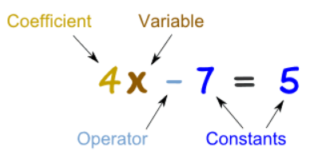
An equation is a sentence that states that two mathematical expressions are equal.
  Example: 2x-16=18
A coefficient is a number used to multiply a variable.

Slide 4

What will happen if you add or subtract an equal amount of weight on both sides of the scales?
Solving equations is like balancing scales, we must always keep the sides equal.

Slide 5


A Question of Balance
What happens if we change one of the sides of a balanced equation?
8 + 3
+ 1
8 + 3 + 1
11
Then it is not balanced!

Slide 6
A Question of Balance
What happens if we change one of the sides of a balanced equation?
+ 1
11
8 + 3 + 1
We need to make the same change to the other side!
Then it is not balanced!

Slide 7

Solving equations is just a matter of undoing operations that are being done to the variable.
In a simple equation, this may mean that we only have to undo one operation, as in the following example.
Solve the following equation for x x + 3 = 8
x + 3 = 8 the variable is x
x + 3 – 3 = 8 – 3 we are adding 3 to the variable, so to get rid of the added 3, we do the opposite--- subtract 3.
x = 5 remember to do this to both sides of the equation.

Slide 8
In an equation which has more than one operation, we have to undo the operations in the correct order. We start with the operation the farthest away from the variable.
Solve the following equation: 5x – 2 =13
5x – 2 = 13 The variable is x
5x – 2 + 2 = 13 + 2 We are multiplying it by 5, and subtracting 2
First, undo the subtracting by adding 2.
5x = 15 Then, undo the multiplication by dividing by 5.
5 5
x = 3

Slide 9
Suppose there are variables on both sides of the equation. The trick now, is to get the variables on the same side by adding or subtracting them.
Solve for x in the equation 4x + 5 = x – 4
We have two terms with
the variable, 4x and x. 4x + 5 = x - 4
We’ll move the variable 4x – x = x – x - 4
with the smaller 3x + 5 = -4
coefficient, x. To do this
we have to look at the
sign in front of the variable
we’re moving. Since the is no
sign we know it is +. To move this
Variable we do the opposite, so we’’ll subtract
x from both sides.

Slide 10
Now we proceed as before:
3x + 5 = -4
3x + 5 – 5 = -4 – 5 Subtract 5 from both sides.
3x = -9
3 3 Divide both sides by 3. x = -3

Slide 11
Addition Property of Equality – states you can add the same amount to both sides of an equation and the equation remains true.
2 + 3 = 5
2 + 3 + 4 = 5 + 4
9 = 9 ? true
Subtraction Property of Equality – states you can subtract the same amount from both sides of an equation and the equation remains true.
4 + 7 = 11
4 + 7 – 3 = 11 – 3
8 = 8 ? true

Slide 12
Addition and subtraction are inverse operations, which means they “undo” each other. To solve an equation, use inverse operations to isolate the variable, or to get the variable on one side of the equal sign by itself. x + 4 = 9 subtract 4 from both sides x + 4 – 4 = 9 – 4 Subtraction property of equality x + 0 = 5 Identity Property of Zero: x + 0 = 5 check: x + 4 = 9
5 + 4 = 9 substitute 5 for x
9 = 9 ? true

Slide 13
w – 3 = 9 Add 3 to both sides w – 3 + 3 = 9 + 3 Addition Property of Equality w + 0 = 12 Identity Property of Zero: w + 0 = w check:
12 – 3 = 9 Substitute 12 for w
9 = 9 ? True
It is very important to write all the steps and check your answer each time you solve an equation.

Slide 14
Solving Equations by Multiplication or Division
Multiplication Property of Equality – states you can multiply the same amount on both sides of an equation and the equation remains true.
4 · 3 = 12
2 · 4 · 3 = 12 · 2
24 = 24
Division Property of Equality – states you can divide the same amount on both sides of an equation and the equation remains true.
4 · 3 = 12
4 · 3 = 12
2 2
12 = 6
2

Slide 15
Multiplication and Division are inverse operations, which means they “undo” each other. To solve an equation, use inverse operations to isolate the variable, or get the variable on one side of the equal sign by itself.
7x = 35 Divide both sides by 7.
7x = 35 Division Property of Equality
7 7
1x = 5 1 · x = x
X = 5
Check:
7x = 35
7 (5) = 35 substitute 5 for x
35 = 35 ? true

Slide 16
Given that P = 2(l + w), l = 3cm and P = 24cm.
What is w?
Substitute in the values you know.
24 = 2(3 + w)
Now solve the equation.
24 = 2(3 + w)
12 = 3 + w
9 = w
So w = 9cm.
÷ 2
÷ 2
–3
–3

Slide 17
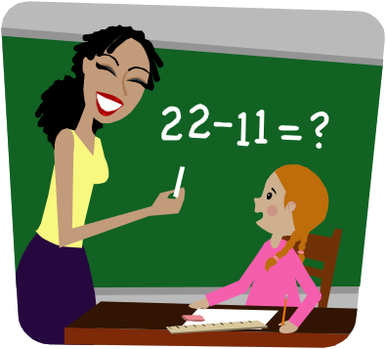
Evaluating and solving simple expressions and equations, using order of operations, and using variables to solve real-world problems is the first step to becoming “good” at math. These skills lay the foundation for studies of algebra, geometry, and statistics.

Slide 18
Read pages 85-92
Complete Ex 6A

